Slide 1
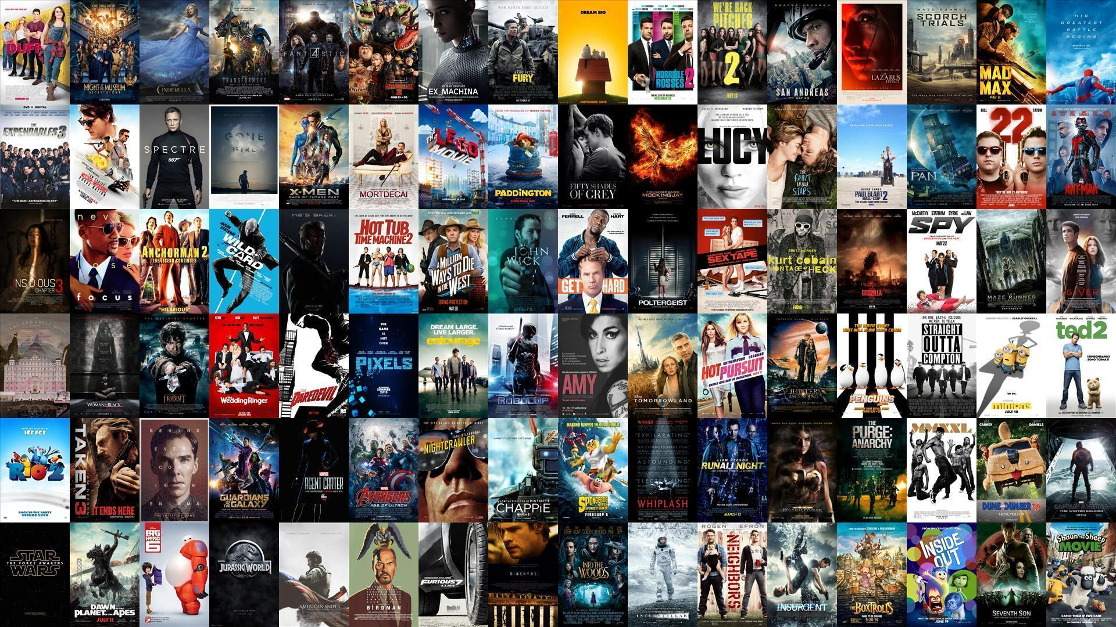
Sprint 2 - Moviender
Agile Methods for Data Science
Team: A3
11/28/2024

Slide 2

Product Vision
Have you ever been on a movie night but could not find the perfect movie?
Moviender is the solution for you! An easy-to-use and interactive website that always recommends you the perfect movie for your occasion.
Notes:
Start the presentation recalling you our project and our final idea
Last time we started asking you a question: have you ever spent hours scrolling netflix looking for a movie to watch without finding anything?
But we also gave you THE solution: our movie reccomendation system Movinder: easy, interactive, perfect for each occasion and thought for YOU

Slide 3
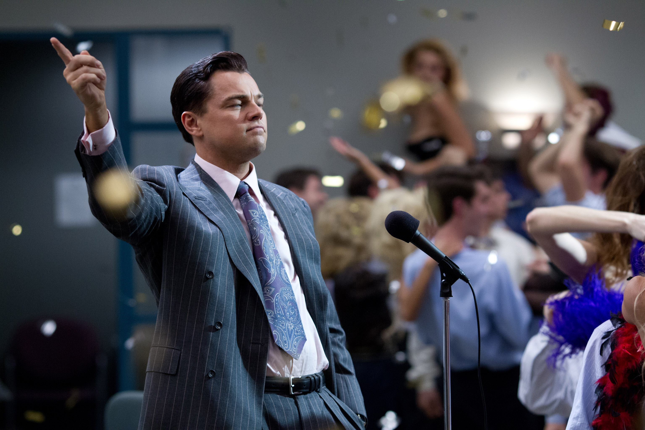
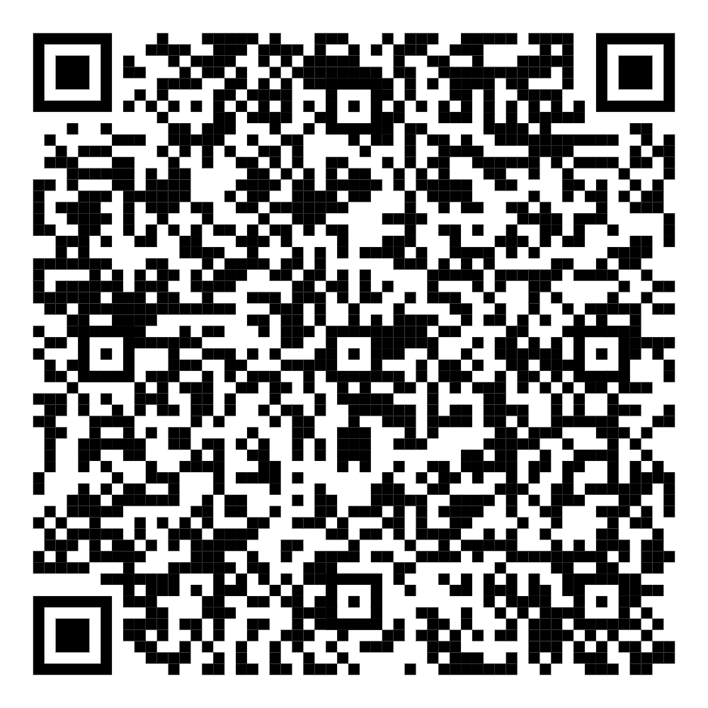
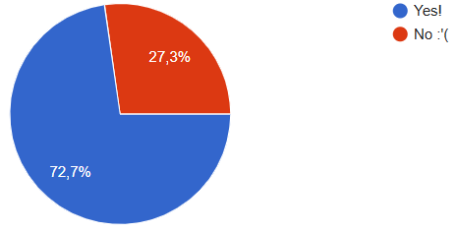
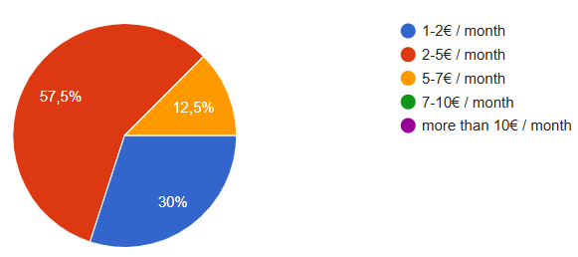
Capability of the project
Scan me!
Would you be willing to purchase a monthly subscription to our website?
How much would you be willing to pay per month?
Notes:
Before presenting you all the progress that we made during these 2 weeks, I’d like to show you why you must trust us and our project
We did a market research: we asked these two questions to a sample of people of different nationalities between 18-30 y/o since they represent the main customers for Netflix and all the other streaming websites that are our competitors
From the results we can see that a large majority of the sample is interested in the project
Moreover, from this preliminary market research, we can also infer a first price for the Premium subscription

Slide 4
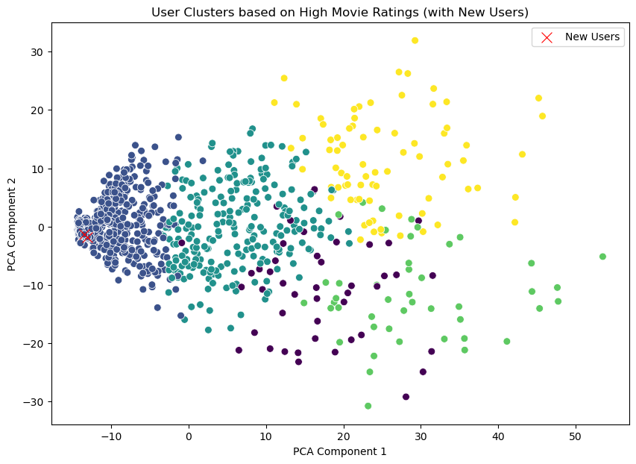
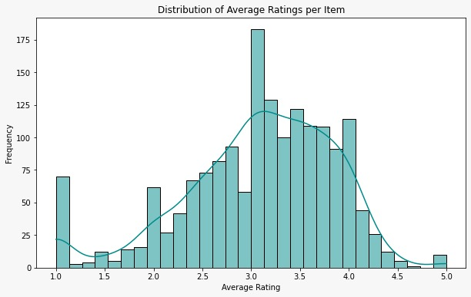
Updates - model
First version:
KMeans
Like/dislike
Second version:
10-NN
Rating 1-5
Notes:
But I know that you are also interested in all the updates that we have developed in these two weeks
I’d like to start by presenting you the model that we have finally selected since performing the best model selection has been the most challenging part of this sprint
We started developing the idea of the like/dislike button as we described you two weeks ago
However, after a better understanding of the ds, we saw that the movies were rated into a scale from 1 to 5
So, our first idea has been to convert these rates into a binary value
Punti problematici: sebastian

Slide 5
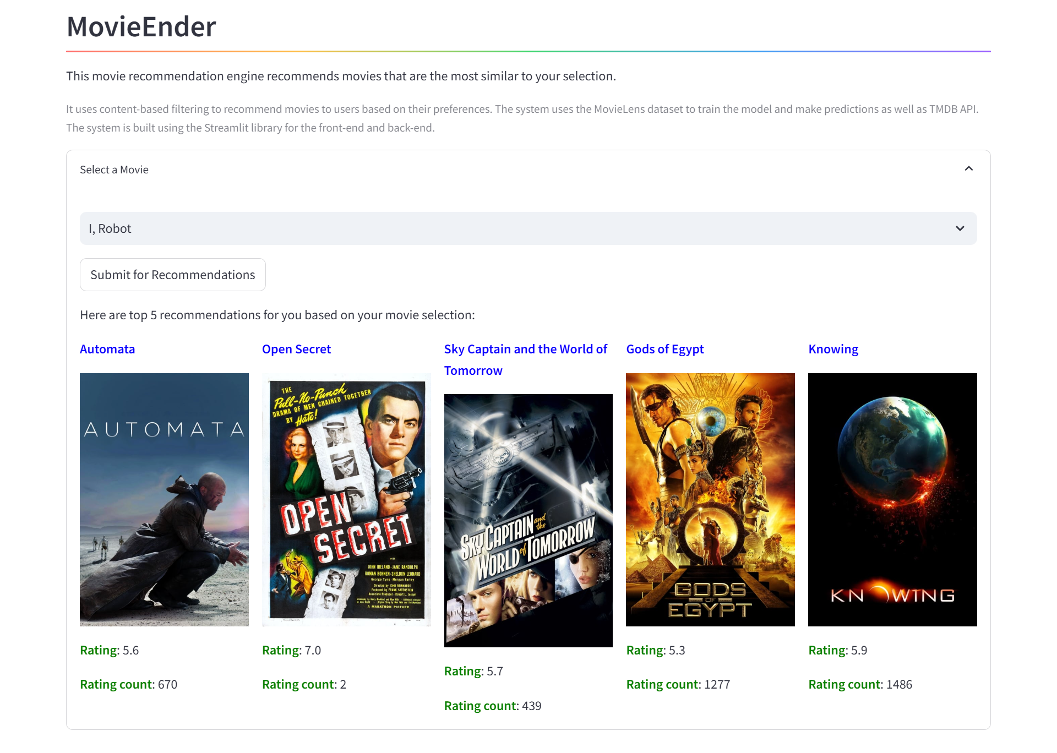
Updates - website

Slide 6
Let‘s revolutionise movie nights together! Moviender

